Slide 1
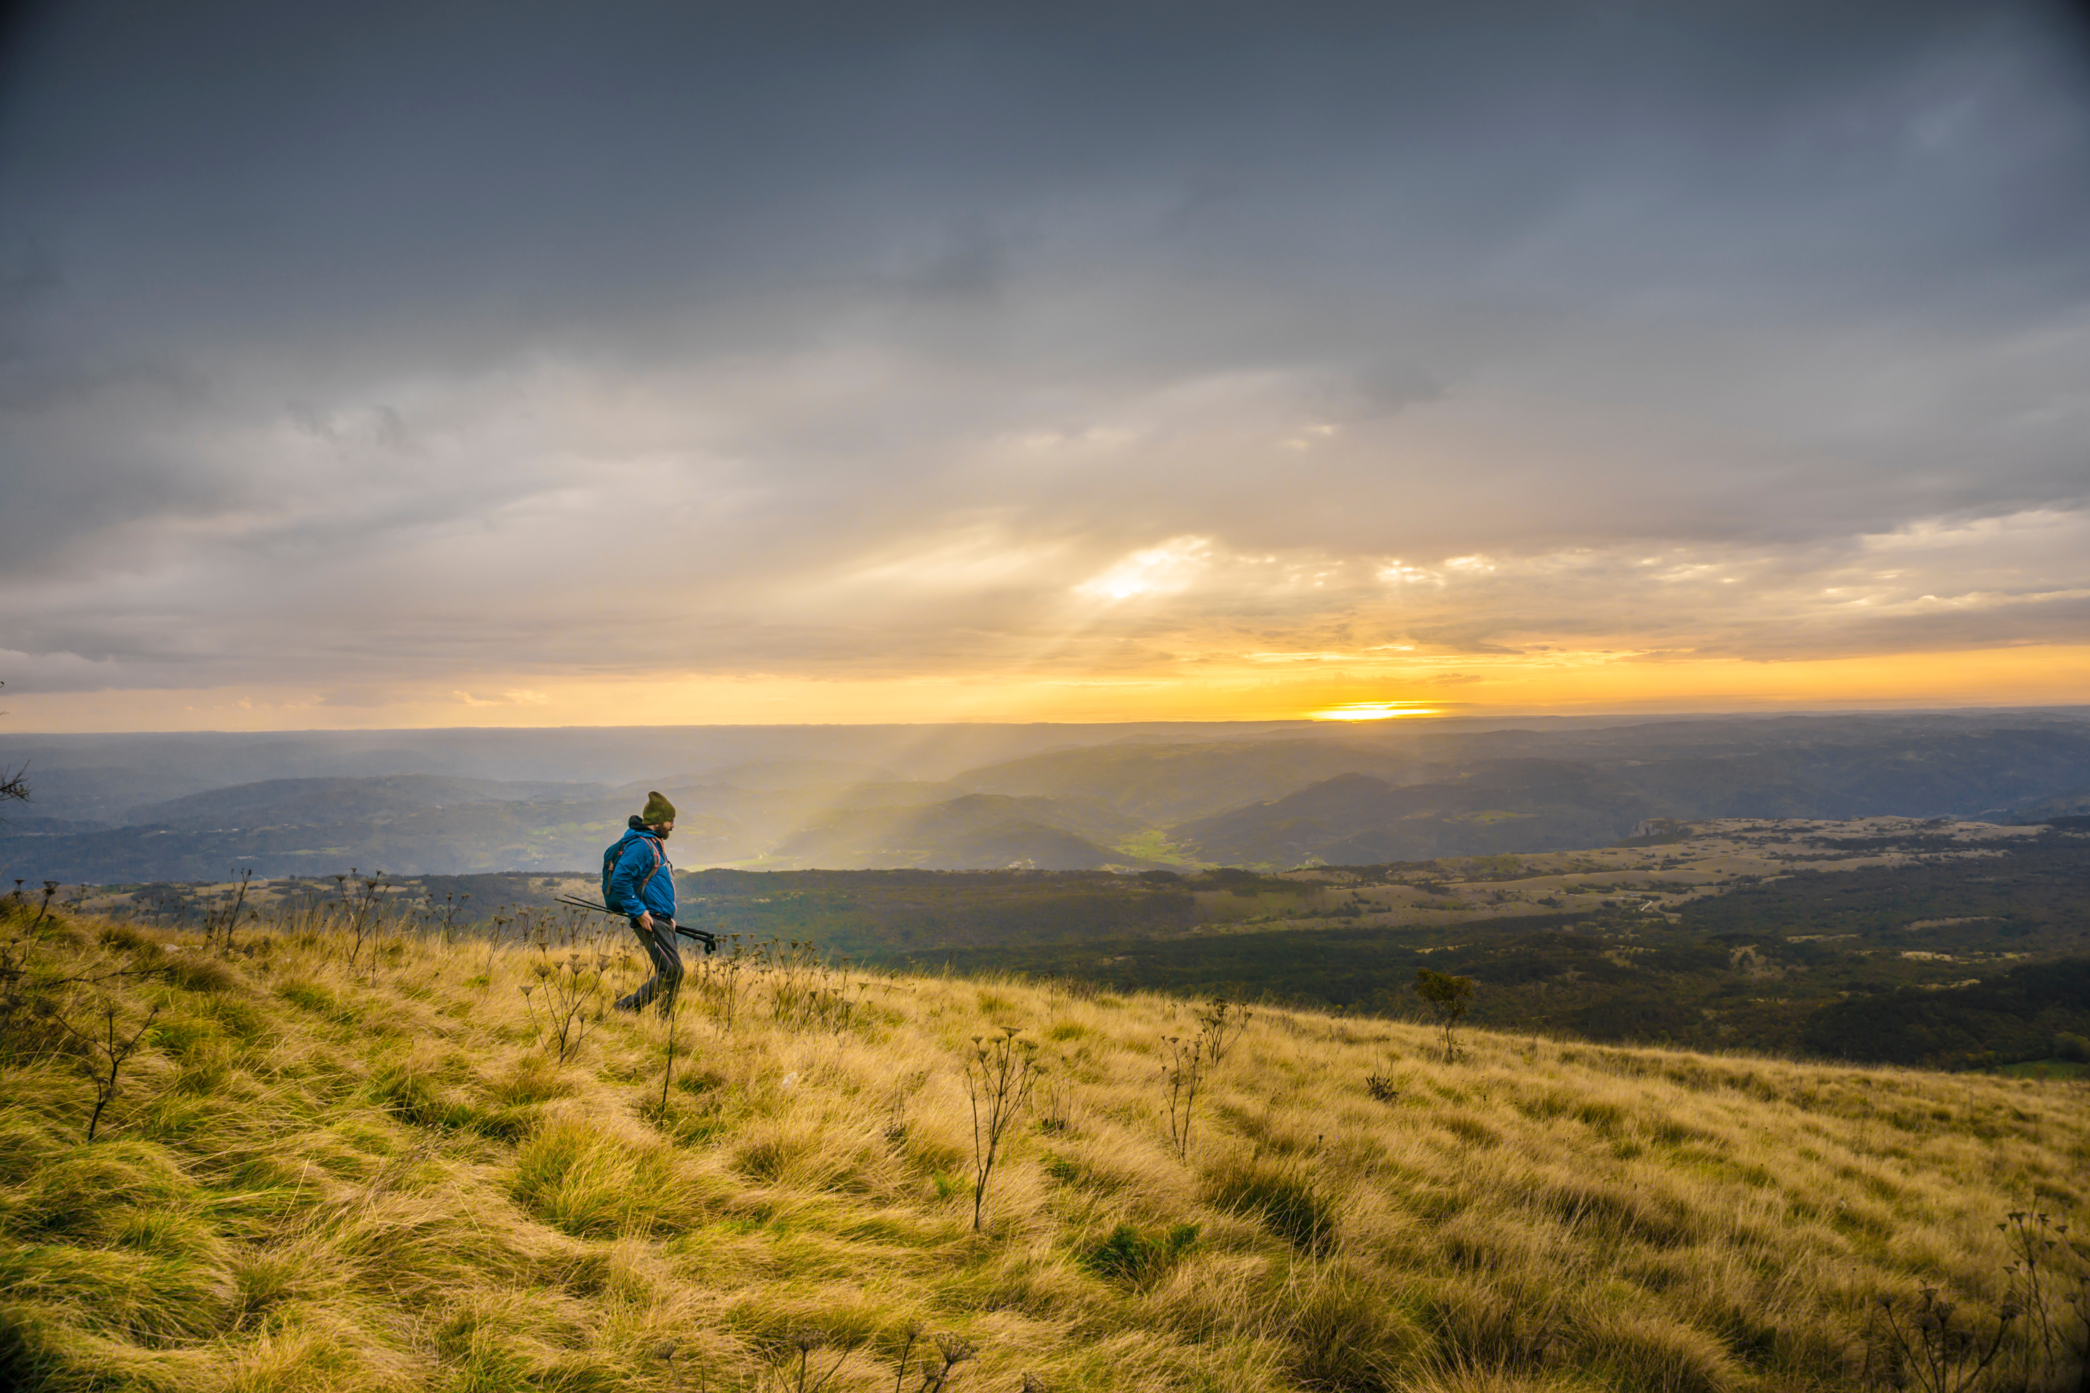


Developmental Disorder Trends in San Diego
Team Name: The G’s of GIS
Members: Nevin Valles, Ryan Carl
Developmental Disorder Trends in San Diego
Big Data Hackathon San Diego 2017

Slide 2
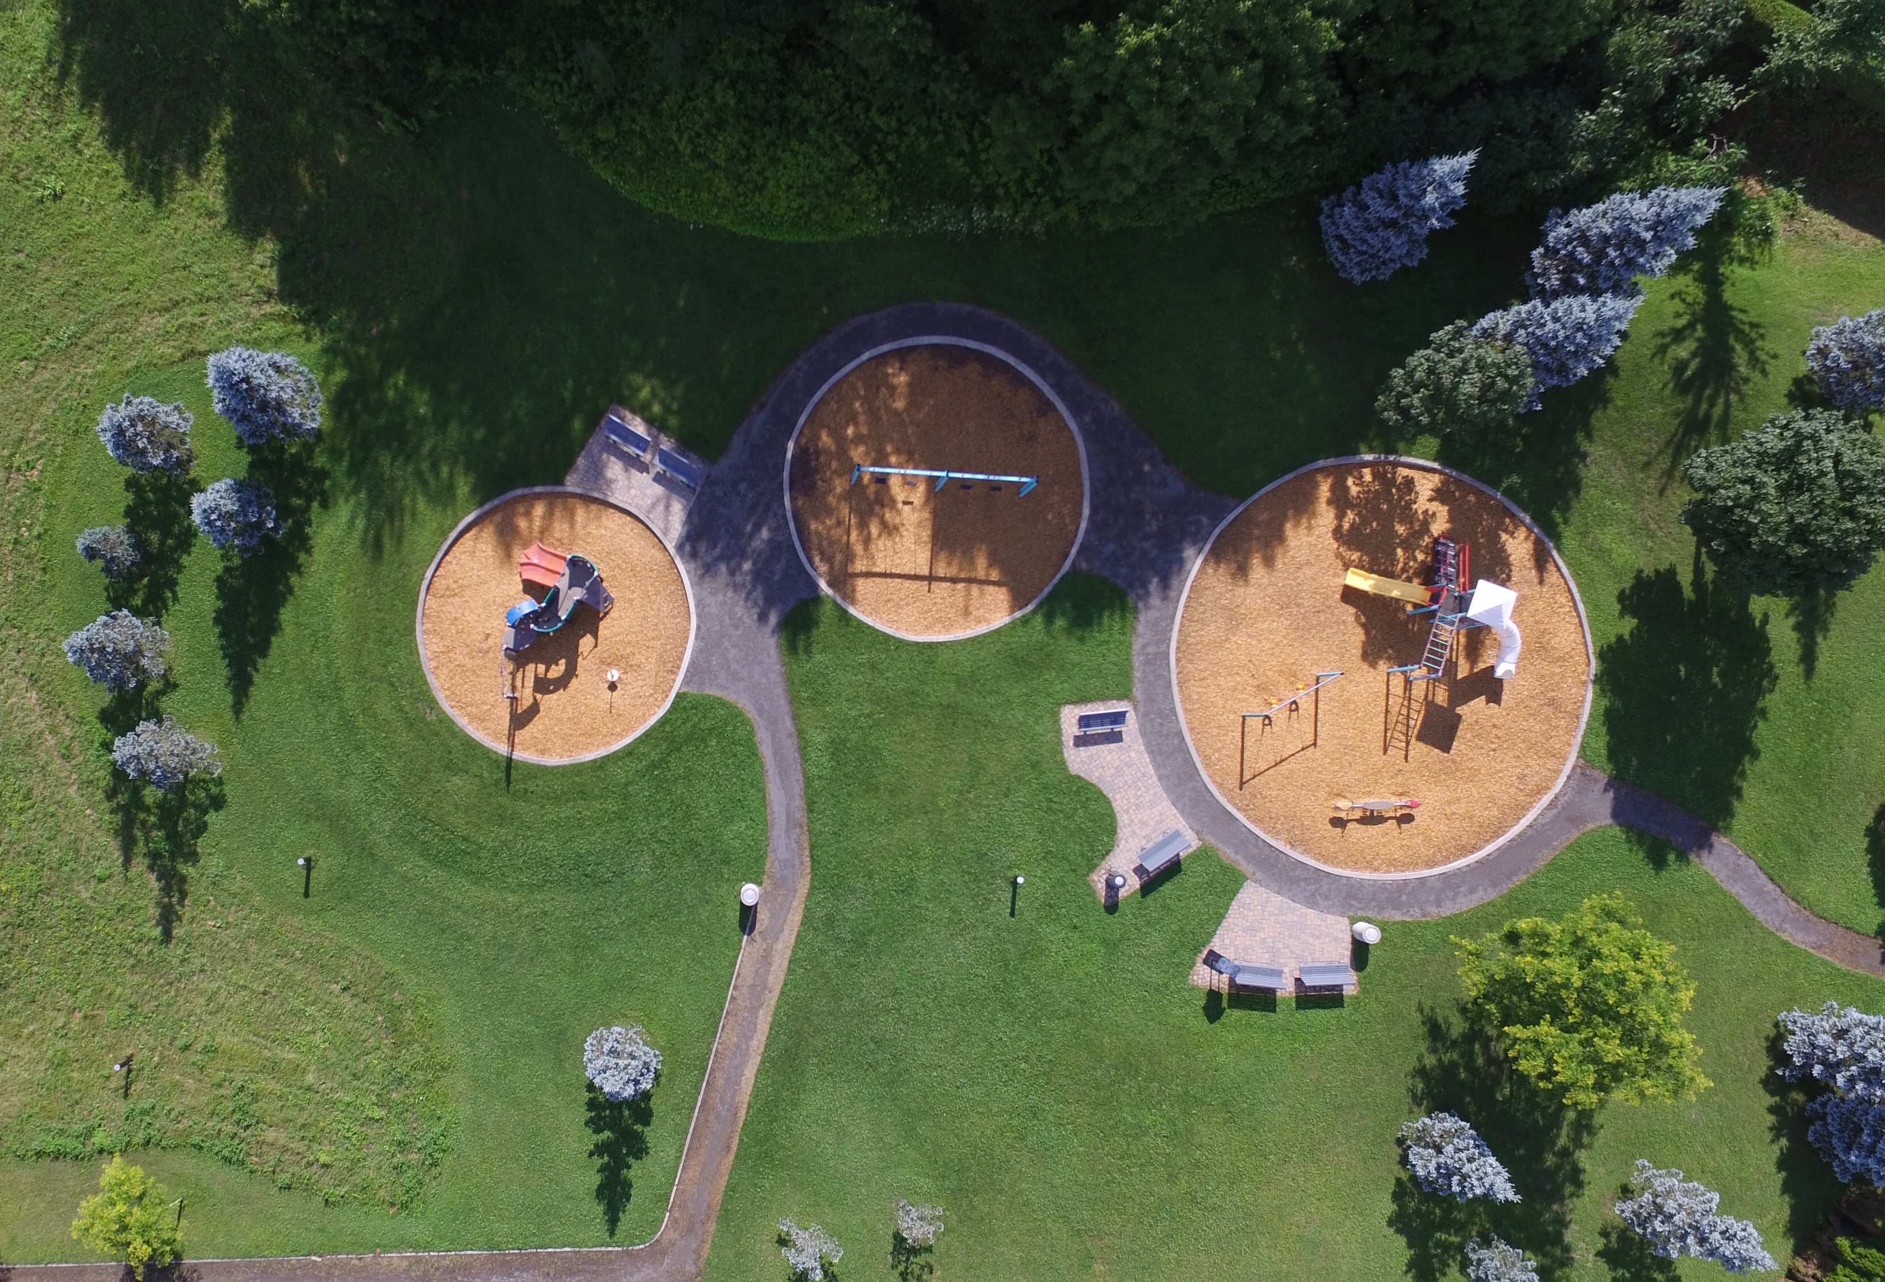
Public Health Questions
How can we show trends of public developmental disorder data and make it easily comprehensible to any user?
Do parks/ open spaces & nature have a positive influence on subregions developmental disorders?

Slide 3
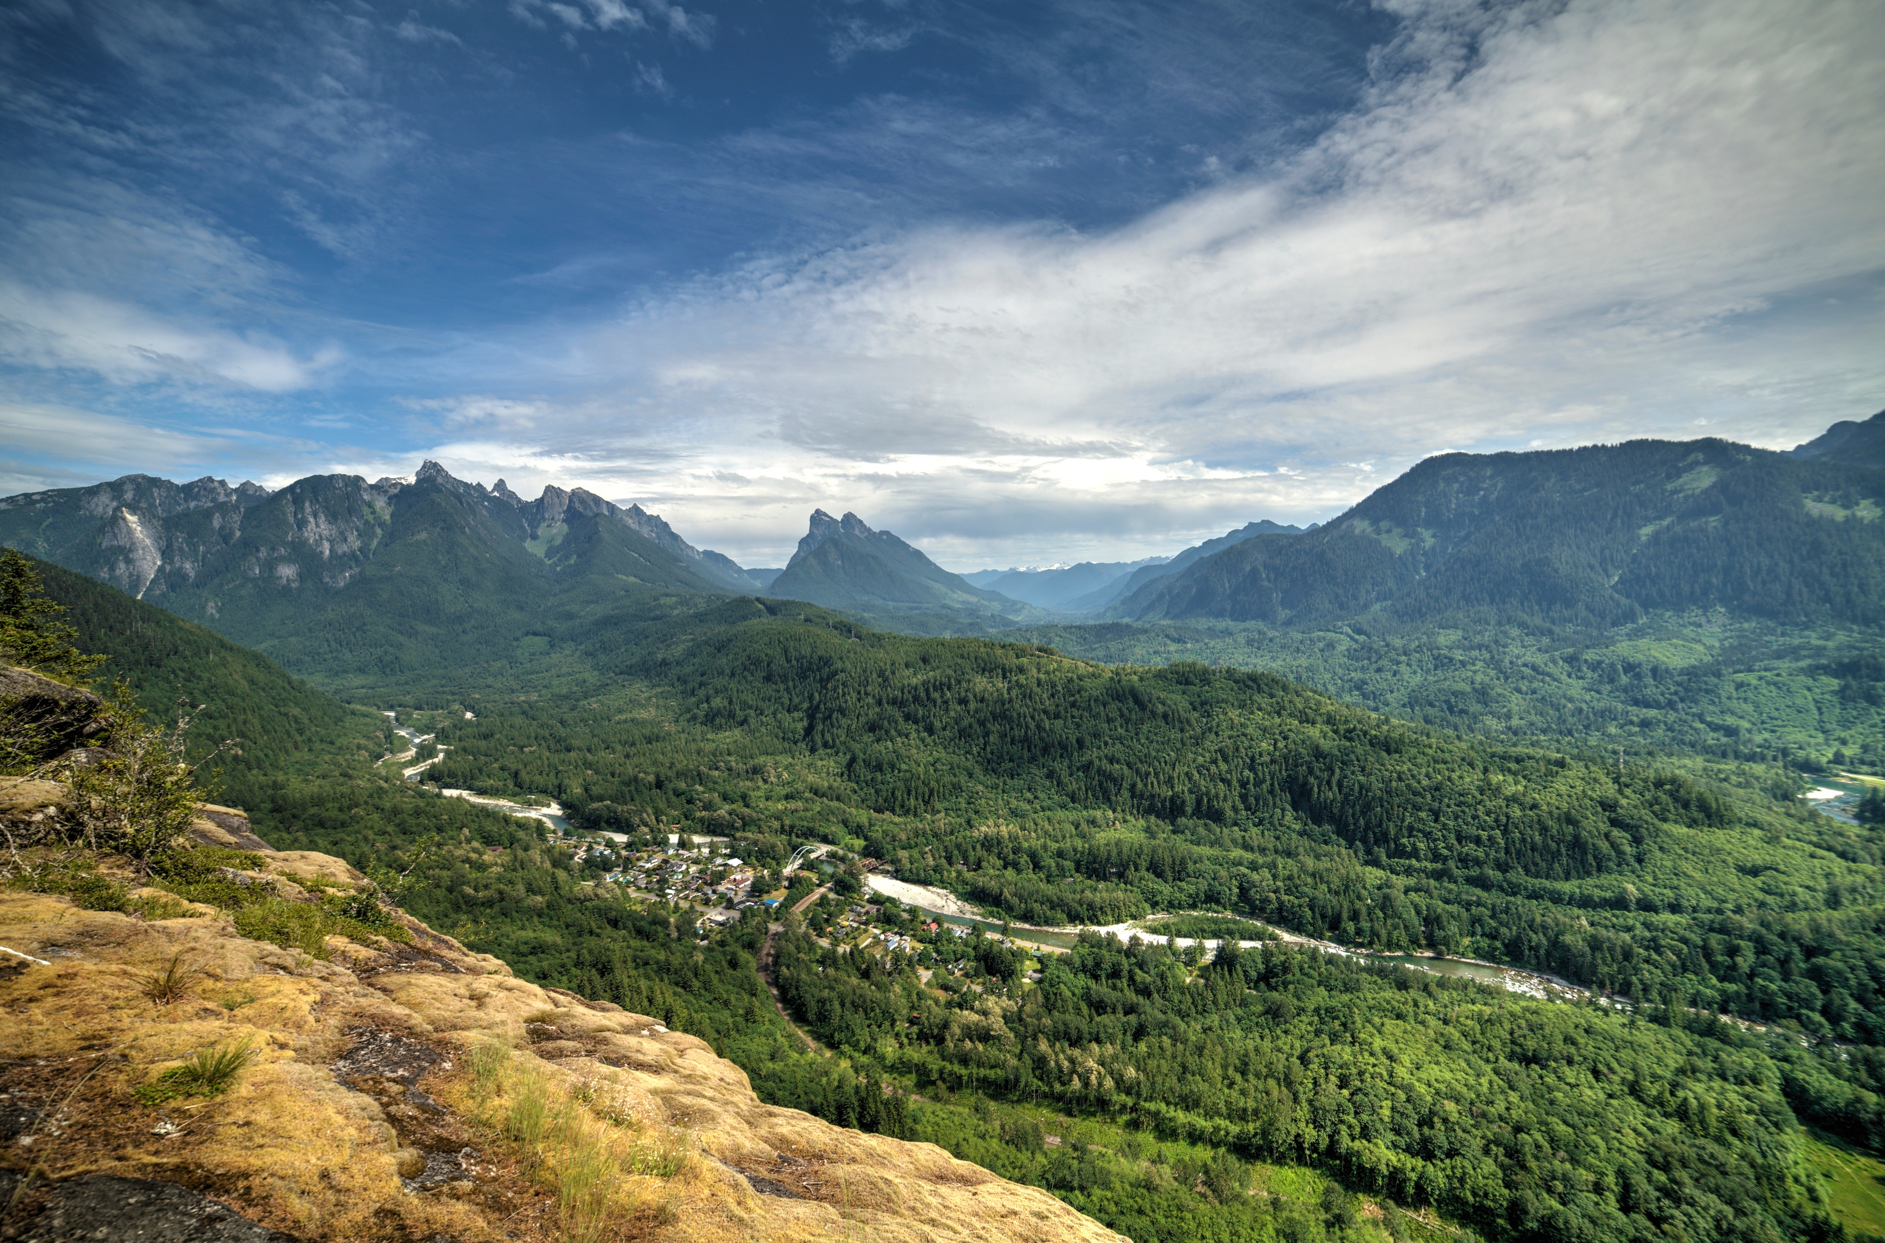
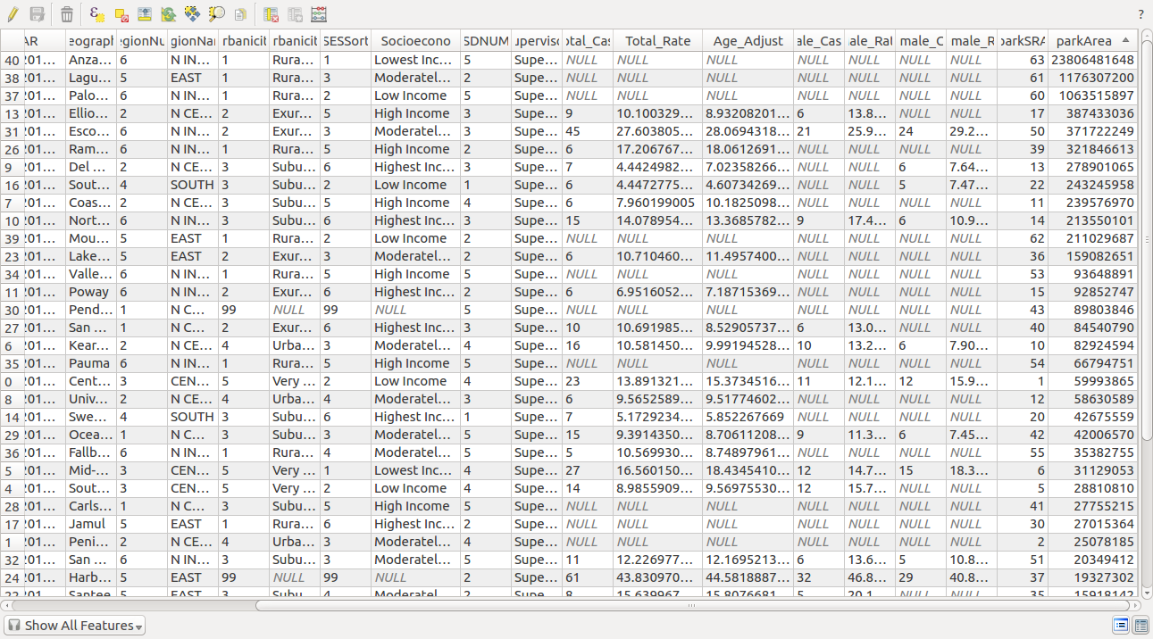
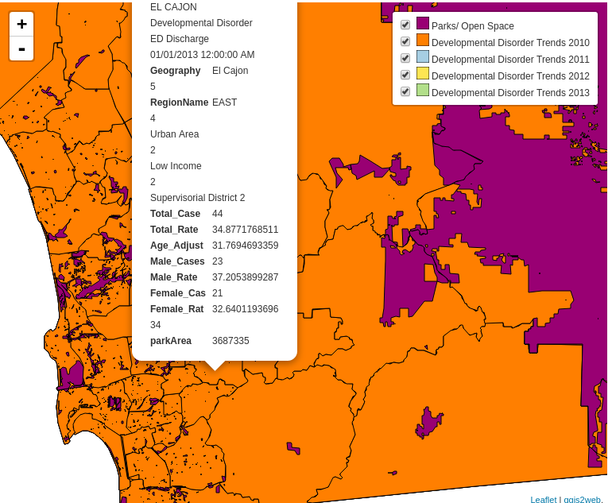

Slide 4

The Impact of this Project on Public Health/ Next Steps to Launch the Project
This project creates easily accessible and comprehensible visual data for the public to analyze. The public can interact with the data from the point of a modern dynamic web based application, created in the interest of the public. Leveraging the power, digital services ensures the ability to maintain the public project with simplicity and effectiveness.
Allocation of more data in the interest of investigating further Geographic Information sciences related public health questions.

Slide 5

Demonstration
Links: http://hack4sdsu.herokuapp.com/admin/
mapping/mapping1.herokuapp.com
mapping/mapping2.herokuapp.com
Sources:
https://data.livewellsd.org/Behavioral-Health/Developmental-Disorder-ED-Discharge-2010-2013/fsts-j5af
http://www.icd9data.com/2012/Volume1/V01-V91/V40-V49/V41/V41.0.htm
http://www.sandag.org/index.asp?subclassid=100&fuseaction=home.subclasshome

